Slide 1
Become a better C# Developer Types
Kathleen Dollard
.NET Languages PM, Microsoft

Slide 2
The plan…
Things we haven’t chatted about recently
Equality
Heap/stack and allocations
Value/reference
Garbage collection
When not to use ref struct and friends
Choosing class vs. struct
record
Primary constructors

Slide 3
 | Default passed by | Equality
class | ref | ref
struct | value | value
ref struct | ? | ?
record class (1) | ref | (generated) value
record struct (1) | value | (generated) value (2)
(1) record is just a modifier that adds the full set of value based equality to a class or struct
(2) The generated equality for record struct includes the == operator and is more efficient than the default struct comparison, so generally use record struct, rather than struct when not defining your own equality. Also, generated equality is correct, avoiding problems you might overlook

Slide 4
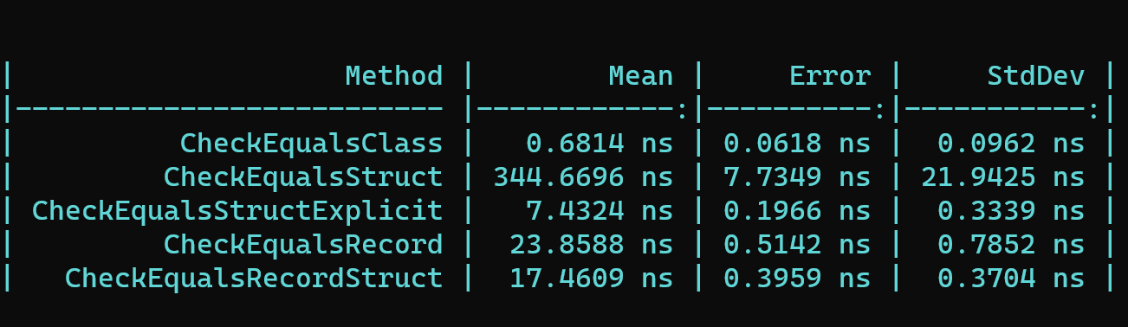
Records structs are much faster
This is a casual benchmark to show the big differences – orders of magnitude
This is not evidence for difference differences in the value equality.

Slide 5
Heap and stack
When an instance of a struct or a class is a local value
And is a class (and record class), it is placed on the heap
And is a struct (and record struct), it is placed are the stack
When a property or field contains an instance of a struct
It is placed where the containing instance is
When a property or field contains an instance of a class
If it is a ref field, the containing instance must be on the stack and it is also placed on the stack
Otherwise, it is placed on the heap

Slide 6
Equality
Puzzles

Slide 7
Stack/heap review

Slide 8
Heap and stack review
Stack
Heap
Value types
Pointers to instances
Instances of reference types

Slide 9
Heap and stack review
Stack
Value types
Pointers to heap items
ref struct like Span<T>
Heap
Reference types
Boxed value types
Span<T> values may be on the stack or heap

Slide 10
A few kinds of memory management
Ref counted (VB6)
None (C++)
Traced GC (C#/VB.NET)
.NET

Slide 11
Tracing Garbage Collection
$$☺$$
$$☺$$
$$☺$$
$$☺$$
$$☺$$
$$☺$$
$$☺$$
Roots
Stack
Static data

Slide 12
Tracing Garbage Collection
$$☺$$
$$☺$$
$$☺$$
$$☺$$
$$☺$$
$$☹$$
$$☺$$
$$☺$$

Slide 13
Depending on platform design, it is either expensive to create or it is expensive to destroy objects accessed via pointers
In .NET, cheap to create, not so cheap to destroy
So, things hang around until reclaiming memory is required or convenient
So, avoid allocations, especially those that survive to Gen2 and are not needed until end of app lifetime

Slide 14
Heap
How do objects wind up on the heap?
new()
Boxing
ref type
value type
Notes:
Prior to .NET 4.5, LOH had compaction issues
Objects wind up on the heap via “new” and boxing

Slide 15
Heap
Large
Small

Slide 16
Heaps
Large
Small

Slide 17
Heaps
Small
Large
Large GC is different
NOTE:
Prior to .NET Framework 4.5, the large object heap had compaction issues
(.NET Core is fine, including 3.x)
Large
Large
small
Large
small
small
Notes:
.NET Core Large is 85K

Slide 18

Large Object Heap

Slide 19
Large Object Heap

Slide 20
Large Object Heap

Slide 21
Large Object Heap

Slide 22
Small Object Heap

Slide 23
Small object heap
Notes:
Prior to .NET 4.5, LOH had compaction issues
Objects wind up on the heap via “new” and boxing

Slide 24
Pointers Removed as App Runs
Notes:
Prior to .NET 4.5, LOH had compaction issues
Objects wind up on the heap via “new” and boxing

Slide 25
Pointers Removed as App Runs
Notes:
Prior to .NET 4.5, LOH had compaction issues
Objects wind up on the heap via “new” and boxing

Slide 26
Garbage Collection Starts

Slide 27
Small
Gen 0
Gen 1
Gen 2
Notes:
Which might possibly affect performance?
Which happen in background? (it depends)

Slide 28
Small
Gen 0
Gen 1
Gen 2
Notes:
Which might possibly affect performance?
Which happen in background? (it depends)

Slide 29
Small
Gen 0
Gen 1
Gen 2
Notes:
Which might possibly affect performance?
Which happen in background? (it depends)

Slide 30
Gen 0 GC
Small
Gen 0
Gen 1
Gen 2
Notes:
Which might possibly affect performance?
Which happen in background? (it depends)

Slide 31
Gen 0 GC
Small
Gen 0
Gen 0
Gen 1
Gen 2
Notes:
Which might possibly affect performance?
Which happen in background? (it depends)

Slide 32
Small
Gen 0
Gen 1
Gen 2
Notes:
Which might possibly affect performance?
Which happen in background? (it depends)

Slide 33
Small
Gen 0
Gen 1
Gen 2
Notes:
Which might possibly affect performance?
Which happen in background? (it depends)

Slide 34
Gen 1 GC
Small
Gen 0
Gen 1
Gen 2
Notes:
Which might possibly affect performance?
Which happen in background? (it depends)

Slide 35
Gen 1 GC
Small
Gen 0
Gen 1
Gen 1
Gen 2
Notes:
Which might possibly affect performance?
Which happen in background? (it depends)

Slide 36
Gen 2 GC
Small
Gen 0
Gen 1
Gen 2
Notes:
Which might possibly affect performance?
Which happen in background? (it depends)

Slide 37
Small
Recent
Not recent
Gen 0
Gen 1
Gen 2
Notes:
Which might possibly affect performance?
Which happen in background? (it depends)

Slide 39
Gen 0 & Gen 1 Collection

Slide 40
Gen 0 & Gen 1 Collection

Slide 41
Gen 0 & Gen 1 Collection

Slide 42
Gen 2 Collection

Slide 43
Gen 2 Collection

Slide 44
Gen 2 Collection

Slide 45
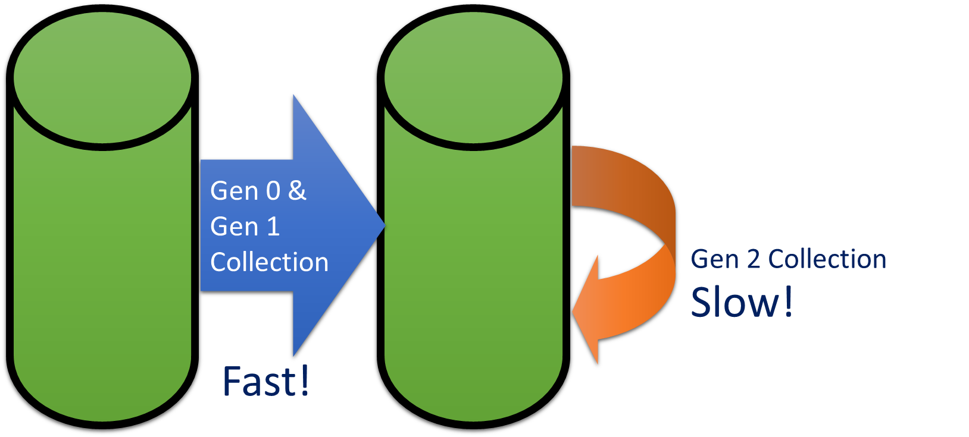
What’s the point?
Endeavour to have objects quickly removed, or live a very long time

Slide 46
Why Three Generations
Gen 0
Objects must have
lived at least
The time length
of Gen 1
Gen 0
Gen 1
Gen 2
Gen 2

Slide 47


Ways You Effect GC
Allocations
Well, this is sort of the point of memory ☺
You don’t have a GC problem, you might have an allocation problem
Design objects to live forever (if they are needed) or be discarded quickly
Avoid boxing
GC settings
Explicitly calling Collect

Slide 48
ref struct and other direct memory access

Slide 49

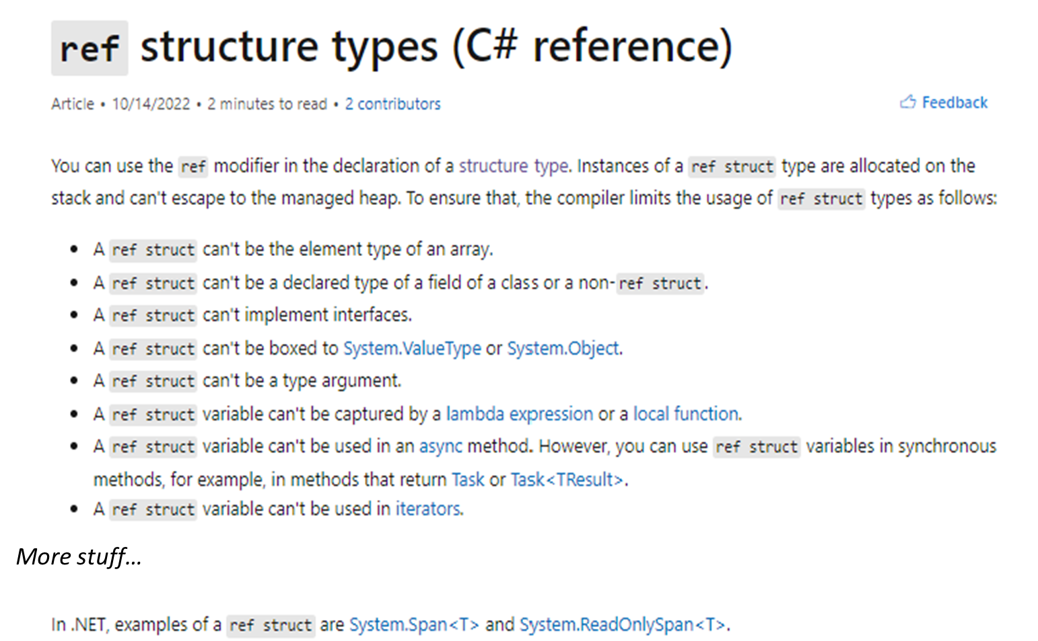
Take time to learn about ref struct and other unsafe guardrails if you plan to use it
- ref struct types - C# reference | Microsoft Learn

Slide 50
Classes, structs and records
Demo first

Slide 51
Deciding between class and struct
Performance may be better with either ref or value types depending on what you are doing
Do you want passing semantics to be value or reference based?
Value semantics → consider struct types
Are your objects very small and accessed frequently as local variables?
Consider struct types
Classes are a good approach, unless one of the above apply or you have profiling data indicating excess allocations

Slide 52
Records demo

Slide 53
Deciding whether to use records
If you are using structs, use records or handcraft your equality
The non-record default struct equality will slow and may be incomplete/incorrect
If you are using classes, do you want value equality or reference equality?
Do you want to know if things are identical or exactly the same thing, which for us means the same location in memory

Slide 54
Discriminated Unions

Slide 55
Discriminated Unions
Do you know what it is?
Typescript or F#?
Tagged unions have names for members, type unions do not
Are performance compromises or allocations OK?
Are typed unions important to you?
Are closed sets important to you?
Are open sets important to you?

Slide 56
DU to aid expanding value sets
public enum PageState
{
NotLoaded,
Loading,
Loaded,
}
...
this.state switch
{
PageState.NotLoaded => ShowLoadButton(),
PageState.Loading => ShowLoadingSpinner(),
PageState. howData => ShowLoadButton(),
_ => Unreachable;
}
...

Slide 57
F# Discriminated Union - Tagged
type Shape =
| Rectangle of width : float * length : float
| Circle of radius : float
| Prism of width : float * float * height : float
You generally deconstruct in a switch to the the specific type

Slide 58
Common DU’s in F#
Result<T, Terror>
Option<T> (this is called “Some” in some languages)
OneOf<T1,T2,T3>

Slide 59
Imaginary syntax – typed unions
void M(union (int|string) x);
// is this the same or a different overload?
void M(union (int|string) x);

Slide 60
Closed vs open set
Default is problematic, regardless

Slide 61
References
More on heap and stack details (not ref struct): Understanding the Stack and Heap in C# | endjin - Azure Data Analytics Consultancy UK

